Slide 1
Physics: from studies to space

Slide 2
Overview
Mechanics: how matter moves
Thermodynamics: how energy is transferred
Optics: how and what we see
Astronomy: how space and our universe operates

Slide 3
Mechanics: the study of motion

Slide 4
Keywords
Mass and inertia
Center of mass
Force
Momentum
Conservation of momentum
Angular motion
Moment of inertia
Torque
Angular momentum
Conservation of angular momentum

Slide 5
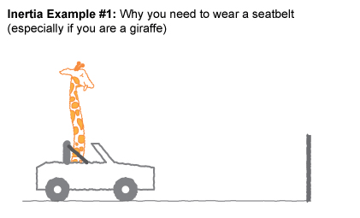
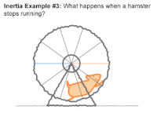
Mass
Mass is the amount of matter in an object.
The more mass an object has, the harder it is to move.
Sometimes, mass is called inertia: the resistance of an object to motion.

Slide 6
Demo: ball drop

Slide 7
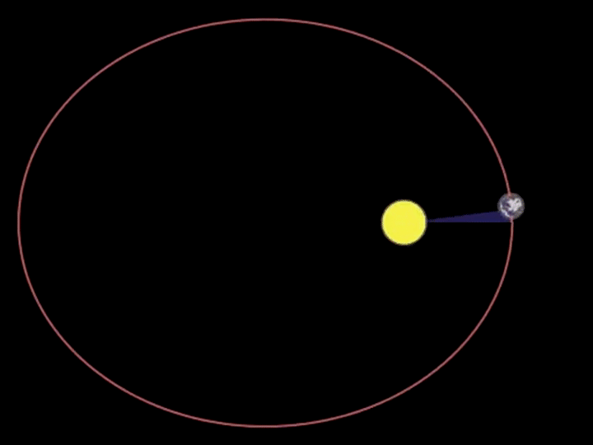

Forces
A force is anything that pushes or pulls on an object.
Forces always cause objects to either speed up or slow down.

Slide 8
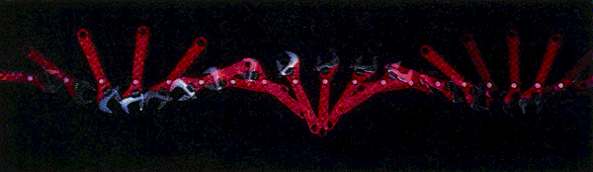

Center of mass
Every object has a “center” when it comes to mass.
All forces (things that push and pull) will act on the object’s center of mass.

Slide 9
Demo: human center of mass

Slide 10
Demo: center of mass of weird shape

Slide 11
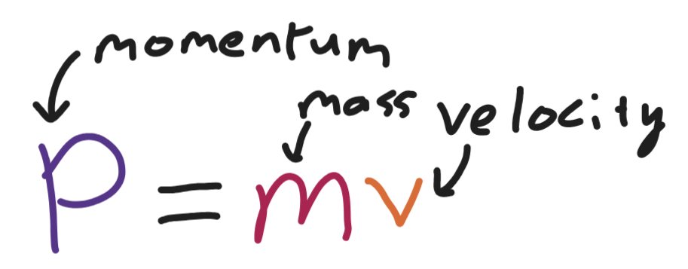
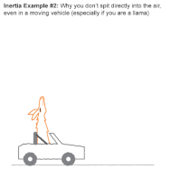
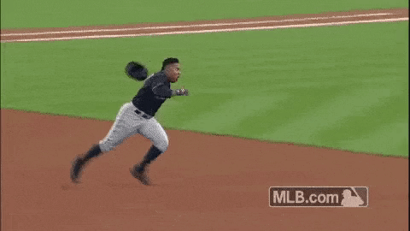
Momentum
Newton’s first law: objects in motion will stay in motion until acted upon by an outside force.
Momentum is a measure of how much an object wants to stay moving!
If two objects are moving at the same speed, the heavier one has more momentum.

Slide 12
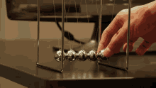
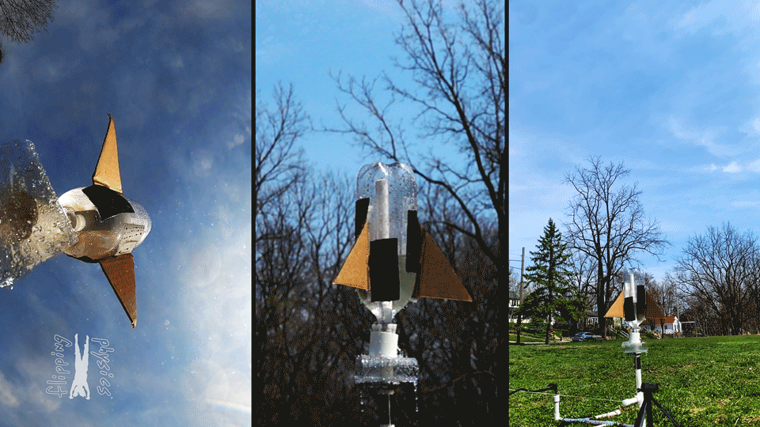
Conservation of momentum
The total momentum of a system (in the absence of force) is conserved. That means it cannot change.
If one object stops moving, another has to start moving faster and vice versa!

Slide 13
Demo: ball drop

Slide 14
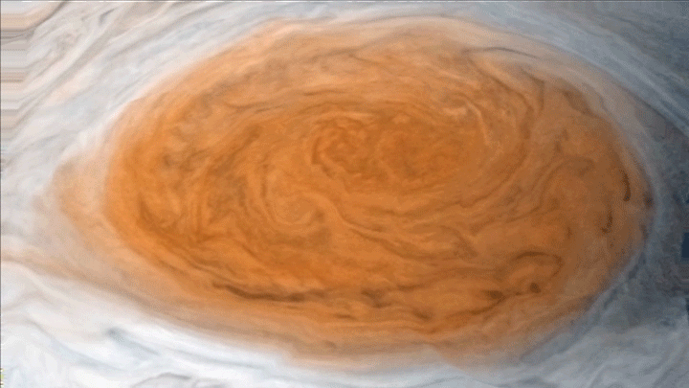
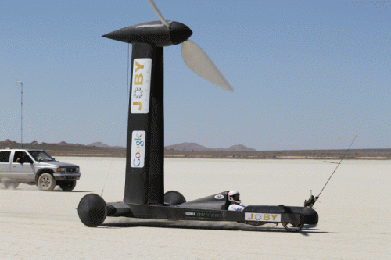
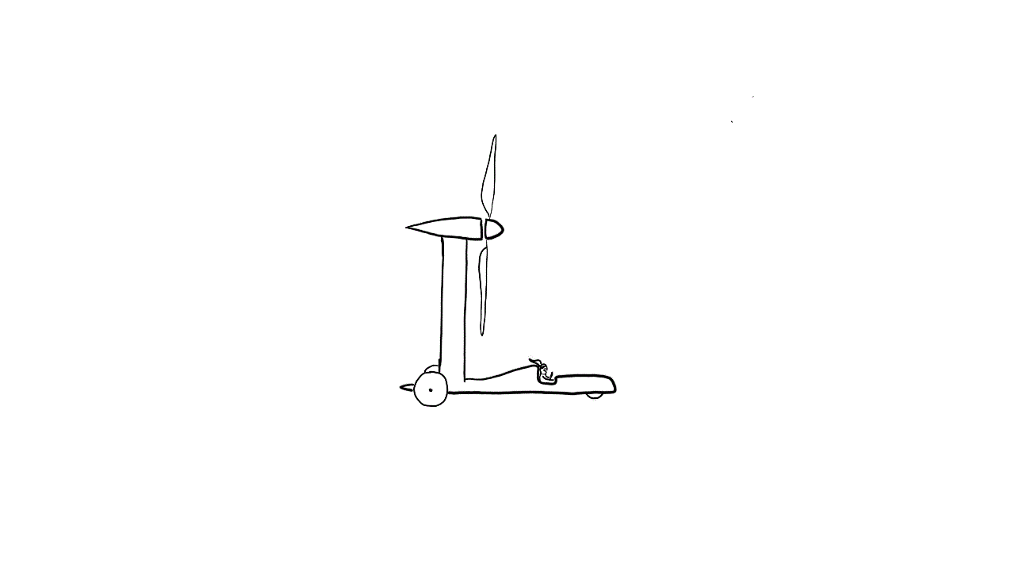
Angular motion
Objects can not only translate (move in a straight line), but they can also rotate.
We can track how much an object rotates using angles!
This is why rotation is called “angular” motion.

Slide 15
Demo: tangent

Slide 16
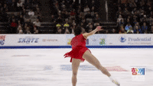
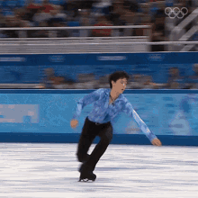
Moment of inertia
Moment of inertia is the rotational analogue of mass.
Objects with a higher moment of inertia are harder to rotate.
If the mass of an object is spread out far, it is harder to spin!

Slide 17
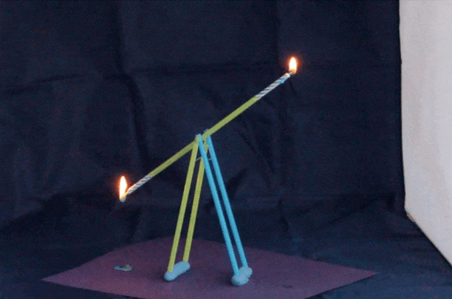
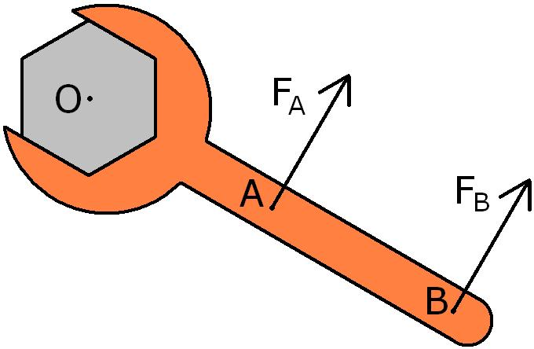
Torque
Force is what causes objects to speed up or slow down.
Torque is what causes objects to rotate faster or slower.

Slide 18
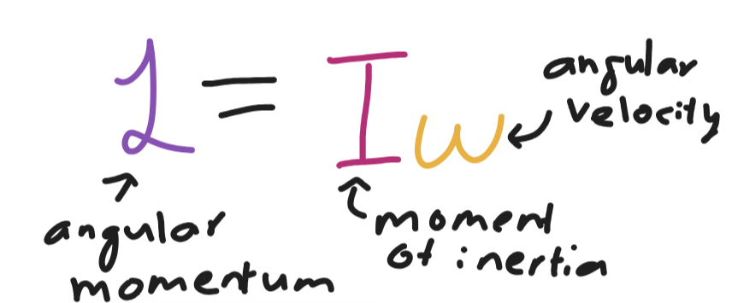
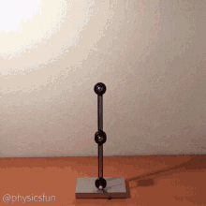
Angular momentum
Objects that are spinning carry an angular momentum.
Like regular momentum, objects with angular momentum want to keep spinning!
Objects with higher moment of inertia will have higher angular momentums when rotating at the same speed.

Slide 19
Demo: spinning with weights

Slide 20
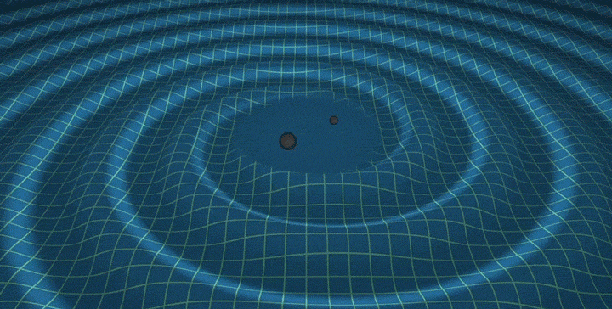

Conservation of angular momentum
Unless a torque is applied, rotating objects will continue rotating.
Decreasing the moment of inertia will cause an object to rotate faster!

Slide 21
Demo: bike wheel

